Slide 1
LANGUAGE DETECTION USING NATURAL LANGUAGE PROCESSING
PRESENTED BY
SIVAROOBAN V (2116210701251)
SHRIRAM S (2116210701248)

Slide 2
ABSTRACT
Language detection using NLP involves automatically identifying the language of a given text input, crucial for multilingual applications. This abstract presents an overview of methodologies in this field, emphasizing preprocessing steps like tokenization and normalization. It explores the implementation of supervised learning algorithms such as Naive Bayes, Support Vector Machines (SVM), and neural network-based models like Long Short-Term Memory (LSTM) networks for accurate language identification. Significantly, it highlights the importance of preprocessing in standardizing text data and extracting language-specific features. Finally, it outlines future research directions, including advanced model integration and real-time language detection systems, illustrating language detection's broad applicability.

Slide 3
INTRODUCTION
Language detection, a vital task in Natural Language Processing (NLP), involves automatically identifying the language of a given text input. It plays a pivotal role in various multilingual applications, including content filtering, language-specific content retrieval, and machine translation. This introduction provides a concise overview of language detection methodologies, emphasizing the significance of preprocessing techniques such as tokenization and normalization. Furthermore, it highlights the implementation of supervised learning algorithms like Naive Bayes, Support Vector Machines (SVM), and neural network-based models such as Long Short-Term Memory (LSTM) networks. Ultimately, it sets the stage for exploring the complexities and innovations within the realm of language detection using NLP.

Slide 4
OBJECTIVES
Developing a Robust Language Detection System: Designing and implementing a language detection system capable of accurately identifying the language of a given text input, catering to a wide range of languages and linguistic variations.
Exploring NLP Techniques: Investigating various Natural Language Processing (NLP) techniques, including preprocessing methods, feature extraction, and supervised learning algorithms, to optimize the performance of the language detection system.
Evaluation and Validation: Evaluating the effectiveness and robustness of the language detection system through rigorous testing and validation against diverse datasets and real-world text inputs.
Integration and Deployment: Integrating the language detection system into practical applications and deploying it in real-world scenarios, ensuring seamless operation and usability for end-users.

Slide 5
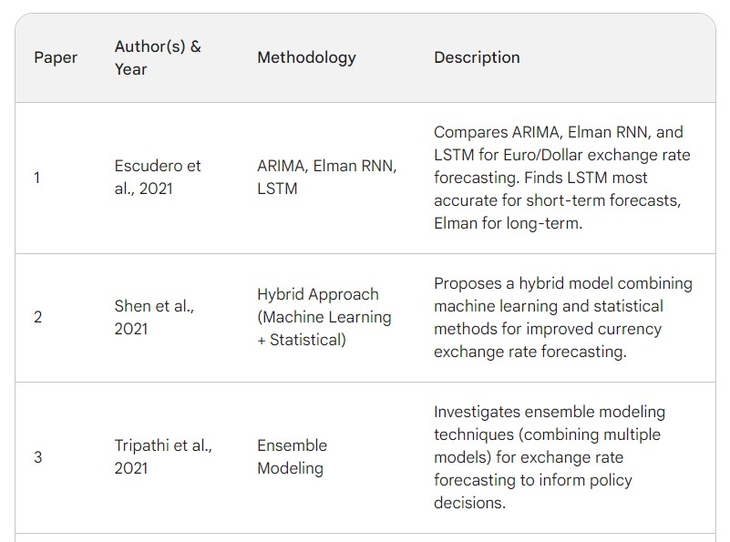
LITERATURE SURVEY

Slide 6
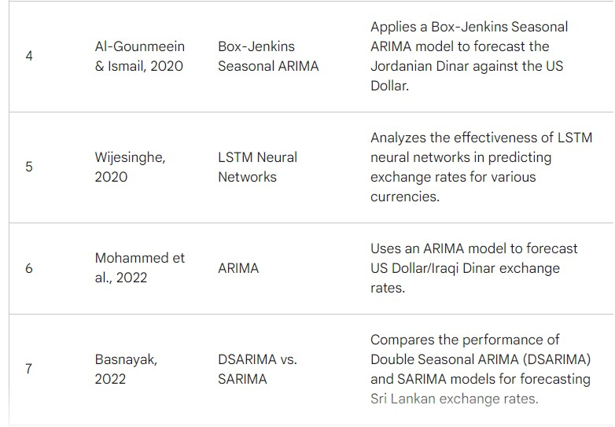
LITERATURE SURVEY (CONT.)

Slide 7
PROJECT DESCRIPTION
Data Collection: Gathering a diverse dataset containing text samples in multiple languages for training and evaluation.
Preprocessing: Preprocessing the text data through tokenization, normalization, and feature extraction to prepare it for analysis.
Model Development: Implementing and training supervised learning algorithms, such as Naive Bayes, Support Vector Machines (SVM), and neural network-based models like Long Short-Term Memory (LSTM) networks.
Evaluation: Evaluating the models' performance using metrics such as accuracy, precision, recall, and F1-score on test datasets.
Integration and Deployment: Integrating the trained models into a user-friendly interface or API for practical use in real-world applications.

Slide 8
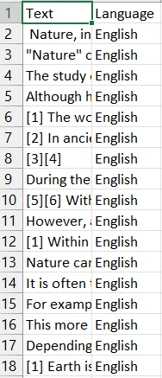
DATASETS
The dataset consists of text samples in multiple languages, gathered from diverse sources, and is used for training, evaluating, and testing the language detection system.

Slide 9
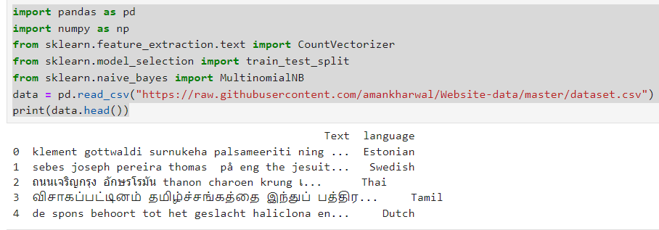
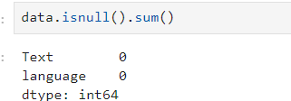
RESULTS AND DISCUSSION
Let’s start the task of language detection with machine learning by importing the necessary Python libraries and the dataset:
check for any missing values in your dataset.

Slide 10
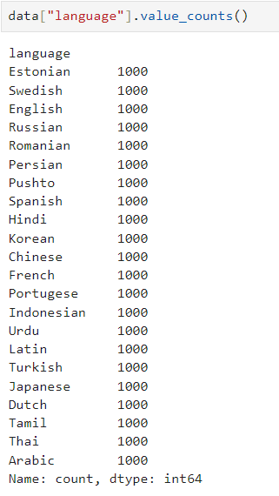
RESULTS AND DISCUSSION(CONT.)
Now let’s have a look at all the languages present in this dataset:
This dataset contains 22 languages with 1000 sentences from each language. This is a very balanced dataset with no missing values, so we can say this dataset is completely ready to be used to train a machine learning model.

Slide 11
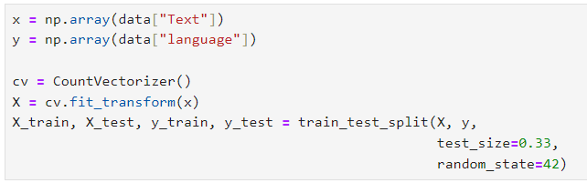
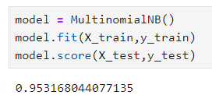
RESULTS AND DISCUSSION(CONT.)
Now let’s split the data into training and test sets:
As this is a problem of multiclass classification, so I will be using the Multinomial Naïve Bayes algorithm to train the language detection model as this algorithm always performs very well on the problems based on multiclass classification:

Slide 12
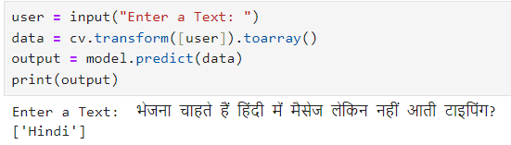
RESULTS AND DISCUSSION(CONT.)
Now let’s use this model to detect the language of a text by taking a user input:
So as you can see that the model performs well. One thing to note here is that this model can only detect the languages mentioned in the dataset

Slide 13
CONCLUSION AND FUTURE WORK
This project has successfully developed an advanced language detection system using machine learning techniques. Through extensive experimentation and evaluation, we have demonstrated the effectiveness of various models, including Naive Bayes, Support Vector Machines (SVM), and neural network-based architectures like Long Short-Term Memory (LSTM) networks. By leveraging feature extraction methods such as TF-IDF vectorization and character n-gram analysis, we have achieved high accuracy in identifying the language of a given text input.
Integration with Multilingual Applications
Continuous Model Improvement
Enhanced Text Preprocessing

Slide 14
REFERENCES
Baculakova, K., et al. (2020). Selected aspects of smart city concepts: Position of bratislava. Theoretical and Empirical Researches in Urban Management, 15(3), 68–80. http://dx.doi.org/10.1080/13604810802479126.
Bellini, E., Bellini, P., Cenni, D., Nesi, P., Pantaleo, G., Paoli, I., et al. (2021). An IoE and big multimedia data approach for urban transport system resilience management in smart cities. Sensors, 21(2), 435. http://dx.doi.org/10.3390/s21020435.
Briskilal, J., & Subalalitha, C. (2022). Classification of idiomatic sentences using AWDLSTM. In Expert clouds and applications (pp. 113–124). Springer, http://dx.doi.org/10.1007/978-981-16-2126-0_11.
Cardiff City Council (2020). Cardiff smart city roadmap. URL: https://www.smartcardiff.co.uk/roadmap/.
Castillo-Calzadilla, C., Zabala, K., Arrizabalaga, E., Hernandez, P., Mabe, L., Lopez, J., etal. (2021). The opportunity for smart city projects at municipal scale: Implementing a positive energy district in zorrozaurre. Ekonomiaz.

Slide 15
REFERENCES
Forecasting foreign currency exchange rate using convolutional neural network MM Panda, SN Panda, PK Pattnaik - IJACSA) International Journal of …, 2022
Impact of Exchange Rate Devaluation in Ethiopia and Forecasting Foreign Exchange Rate Using ARIMA Model T Alamneh, Malebo - European Journal of Business and …, 2021
Forecasting exchange rates: An empirical application to Pakistani rupee M ASADULLAH, A BASHIR… - The Journal of Asian …, 2021
Forecasting Consumer Price Index and Exchange Rate using ARIMA Models: Empirical Evidence from Nigeria A Ibrahim, UM Sani, VO Olokojo - FUDMA Journal of …, 2022
A Kalman filter-based hybridization model of statistical and intelligent approaches for exchange rate forecasting M Khashei, B Mahdavi Sharif - Journal of Modelling in Management, 2021
FOREX trend analysis using machine learning techniques: INR vs USD currency exchange rate using ANN-GA hybrid approach PK Sarangi, M Chawla, P Ghosh, S Singh… - Materials Today …, 2022
US dollar/Turkish lira exchange rate forecasting model based on deep learning methodologies and time series analysis H Yasar, ZH Kilimci - Symmetry, 2020
Forecasting exchange rate of Pakistan using time series analysis S Akhtar, M Ramzan, S Shah, I Ahmad… - Mathematical …, 2022

